Slide 1
From Vision to Value:
Building Profitable AI Foundations

Slide 2






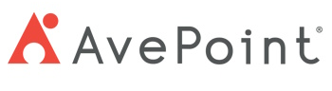

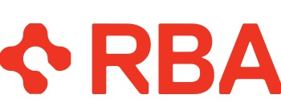
Please thank our sponsors

Slide 3
“The one who becomes the leader in [AI] will be the ruler of the world”
Vladimir Putin
2017

Slide 4
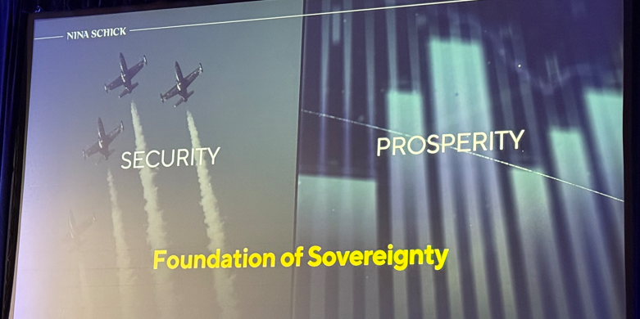
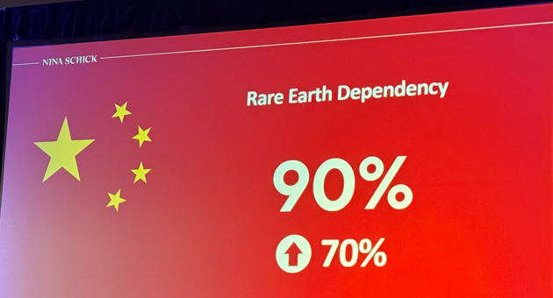
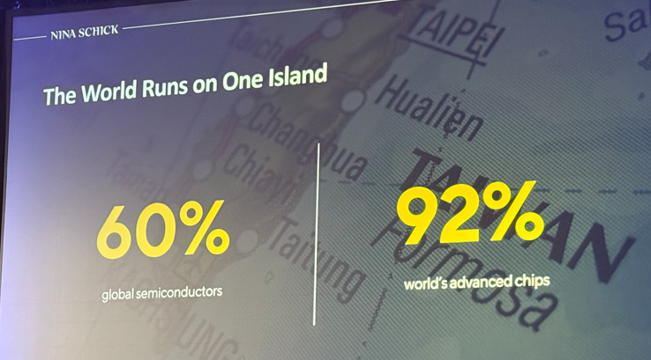
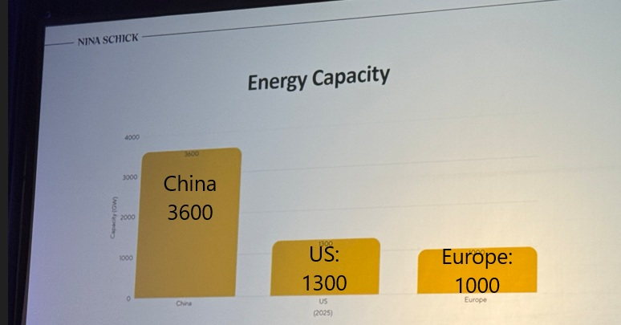
Global AI Resource Dependency
Credit Nina Schick: linkedin.com/in/ninaschick

Slide 5
White House
America’s AI Action Plan | July 2025
An industrial revolution, an information revolution, and a renaissance-all at once. This is the potential that AI presents. The opportunity that stands before us is both inspiring and humbling. And it is ours to seize, or to lose.

Slide 6
If that is the potential and impact of AI for our Society…
What does it mean for your Business?

Slide 7
AI is Merely a Tool
The approach to leveraging AI should be the same as any tool
Business justification needs to exist – don’t spend $20k on a $10k problem
Just like a hammer can drive nails, pull them out, or even break something apart—AI has a range of applications.

Slide 8






Outcomes for Session
AI Vision & Guidelines
AI Vision & Guidelines
Value-Based AI Evaluation Framework
Establish AI Champions Community
Education, Awareness & Exploration of AI Solutions
Deploy/Invest, Iterate & Measure
Oversight – Governance, Risk & Compliance
Value-Based AI Evaluation Framework
Establish AI Champions Community
Education, Awareness & Exploration of AI Solutions
Deploy/Invest, Iterate & Measure
Oversight – Governance, Risk & Compliance

Slide 9
AI Vision & Guidelines
Define the organization's vision for AI, including confidentiality, security, and privacy considerations.
Decide whether to build or subscribe to AI tools, considering the business's core focus.
Recognize that AI is already being used
within the organization and establish clear policies and guidelines.
Consider defining what constitutes confidential information within
the organization.
Communicate the vision and expectations to the team to ensure alignment.
Notes:
Ideas for Visual Aids:
AI Vision and Guidelines:
Flowchart: Illustrate the decision-making process for building vs. subscribing to AI tools, including considerations for confidentiality, security, and privacy.
Infographic: Show the key components of the AI vision, including mission, guiding principles, and policy guidelines.

Slide 10




Value Based AI Evaluation Framework
Establish criteria for evaluating AI initiatives, focusing on ROI and problem-solving potential.
Set a threshold for the minimum value an AI solution should deliver to justify investment.
Consider both cost-saving and opportunity-creating AI initiatives.
Initiatives could be cross-departmental or within a department.
Establish criteria for evaluating AI initiatives, focusing on ROI and problem-solving potential.
Consider both cost-saving and opportunity-creating AI initiatives: inter or intra-departmental.
Set a threshold for the minimum value an AI solution should deliver to justify investment.
Define Suggested Criteria for Prioritizing AI Opportunities.
Notes:
Provide examples of high-priority AI use cases relevant to SMBs.
AI use cases are plentiful, but value and profit driving initiatives should be prioritized.
Initiatives could be cross-departmental or within a department i.e. RFP responses development agent within marketing or sales
Ideas for Visual Aids:
Value-Based AI Evaluation Framework:
Bar Chart: Display the threshold for ROI, comparing different AI initiatives and their potential value.
Matrix: Create a matrix to evaluate AI initiatives based on cost-saving vs. opportunity-creating potential.

Slide 11
Value Based AI Evaluation Framework
Establish criteria for evaluating AI initiatives, focusing on ROI and problem-solving potential.
Set a threshold for the minimum value an AI solution should deliver to justify investment.
Consider both cost-saving and opportunity-creating AI initiatives.
Initiatives could be cross-departmental or within a department.
Establish criteria for evaluating AI initiatives, focusing on ROI and problem-solving potential.
Initiatives could be cross-departmental or within a department.
Set a threshold for the minimum value an AI solution should deliver to justify investment.
Consider both cost-saving and opportunity-creating AI initiatives.
Notes:
Provide examples of high-priority AI use cases relevant to SMBs.
AI use cases are plentiful, but value and profit driving initiatives should be prioritized.
Initiatives could be cross-departmental or within a department i.e. RFP responses development agent within marketing or sales
Ideas for Visual Aids:
Value-Based AI Evaluation Framework:
Bar Chart: Display the threshold for ROI, comparing different AI initiatives and their potential value.
Matrix: Create a matrix to evaluate AI initiatives based on cost-saving vs. opportunity-creating potential.

Slide 12
Value Based AI Evaluation Framework
Establish criteria for evaluating AI initiatives, focusing on ROI and problem-solving potential.
Set a threshold for the minimum value an AI solution should deliver to justify investment.
Consider both cost-saving and opportunity-creating AI initiatives.
Initiatives could be cross-departmental or within a department.
Establish criteria for evaluating AI initiatives, focusing on ROI and problem-solving potential.
Initiatives could be cross-departmental or within a department.
Set a threshold for the minimum value an AI solution should deliver to justify investment.
Consider both cost-saving and opportunity-creating AI initiatives.
Notes:
Provide examples of high-priority AI use cases relevant to SMBs.
AI use cases are plentiful, but value and profit driving initiatives should be prioritized.
Initiatives could be cross-departmental or within a department i.e. RFP responses development agent within marketing or sales
Ideas for Visual Aids:
Value-Based AI Evaluation Framework:
Bar Chart: Display the threshold for ROI, comparing different AI initiatives and their potential value.
Matrix: Create a matrix to evaluate AI initiatives based on cost-saving vs. opportunity-creating potential.

Slide 13
Value Based AI Evaluation Framework
Establish criteria for evaluating AI initiatives, focusing on ROI and problem-solving potential.
Set a threshold for the minimum value an AI solution should deliver to justify investment
Consider both cost-saving and opportunity-creating AI initiatives: inter or intra-departmental
Define Suggested Criteria for Prioritizing AI Opportunities

Slide 14
Establish AI Champions Community
Support champions with education, training, and resources to help them succeed.
Ensure champions are involved in exploring AI solutions and prioritizing initiatives, including ROI validation.
Identify and invest in champions who are curious, understand business processes, and can drive AI initiatives.
Statistically 15% of your company are Champions.
Notes:
Viva engage group.
Build one or more Prompt Libraries to share and assist in adoption
Training & Communication are critical for successful adoption – quote: Reasons for Sabotage: The primary reasons cited by employees for sabotaging AI initiatives included concerns that AI diminishes their value or creativity (33%), fears of job loss due to AI (28%), and dissatisfaction with the quality and security of the AI tools being used (see article referenced lower in this document). Communication around the intention of AI, the future of AI, feedback loop from employees & long-term evolution will be key to improve adoption and effective roll-out of initiatives.
Ideas for Visual Aids:
Establishing a Champions Community:
Organizational Chart: Highlight the champions within the organization and their roles in driving AI initiatives.
Network Diagram: Show the collaboration and communication flow among champions and other team members.

Slide 15
Establish AI Champions Community
70%
70% will follow. Open to change with the right tools and training.
15% are your Champions.
Eager to lead, shape,
and own tools.
15% resist change.
Prefer their own processes and avoid new tools.
15%
15%
Notes:
Viva engage group.
Build one or more Prompt Libraries to share and assist in adoption
Training & Communication are critical for successful adoption – quote: Reasons for Sabotage: The primary reasons cited by employees for sabotaging AI initiatives included concerns that AI diminishes their value or creativity (33%), fears of job loss due to AI (28%), and dissatisfaction with the quality and security of the AI tools being used (see article referenced lower in this document). Communication around the intention of AI, the future of AI, feedback loop from employees & long-term evolution will be key to improve adoption and effective roll-out of initiatives.
Ideas for Visual Aids:
Establishing a Champions Community:
Organizational Chart: Highlight the champions within the organization and their roles in driving AI initiatives.
Network Diagram: Show the collaboration and communication flow among champions and other team members.

Slide 16


Build Awareness & Explore AI Solutions
Educate the Champions team on different types of AI solutions and their potential applications.
Explore Solutions and Engage Potential Vendor Partners.
Educate the Champions team on different types of AI solutions and their potential applications.
Explore Solutions and Engage Potential Vendor Partners
Highlight the importance of understanding how AI solutions interact with data and security.
Determine Trial Opportunities and Overall Time & Financial Commitment
Notes:
Provide examples of AI tools like Microsoft Copilot, Synthrio, and others to illustrate different use cases.
Ideas for Visual Aids:
Building Awareness and Exploring Solutions:
Comparison Table: Compare different AI tools (e.g., Microsoft Copilot, Synthrio) and their use cases.
Timeline: Display the evolution of AI solutions and their integration into the organization.

Slide 17

Types of AI Tools
Embedded AI Tools
AI Features Built into existing software platforms
Instant out-of-the-box setup
Perfect for End Users
Connectable AI Tools
AI Platforms to Build On
SaaS Tools that connect to your data & apply AI
Simple setup with connectors
Perfect for Business Users, Analysts, Product Managers
Full platforms to build custom AI solutions
Requires technical set up
and infrastructure
Perfect for Developers, Data Scientists
Option | Pros | Cons
Build | Full control over features, data, and security Custom-fit to needs Competitive differentiation | High development and maintenance cost Longer time to deploy Requires specialized talent
Subscribe | Fast deployment Lower upfront cost Ongoing vendor support and updates | Limited customization Data privacy concerns Reliance on third-party availability and compliance

Slide 18


Build Awareness & Explore AI Solutions
Highlight the importance of understanding how AI solutions interact with data and security.
Determine Trial Opportunities and Overall Time & Financial Commitment.
Notes:
Provide examples of AI tools like Microsoft Copilot, Synthrio, and others to illustrate different use cases.
Ideas for Visual Aids:
Building Awareness and Exploring Solutions:
Comparison Table: Compare different AI tools (e.g., Microsoft Copilot, Synthrio) and their use cases.
Timeline: Display the evolution of AI solutions and their integration into the organization.

Slide 19

Build Awareness & Explore AI Solutions
Educate the Champions team on different types of AI solutions and their potential applications.
Explore Solutions and Engage Potential Vendor Partners.
Highlight the importance of understanding how AI solutions interact with data and security.
Determine Trial Opportunities and Overall Time & Financial Commitment.
Educate the Champions team on different types of AI solutions and their potential applications.
Explore Solutions and Engage Potential Vendor Partners
Highlight the importance of understanding how AI solutions interact with data and security.
Determine Trial Opportunities and Overall Time & Financial Commitment
Notes:
Provide examples of AI tools like Microsoft Copilot, Synthrio, and others to illustrate different use cases.
Ideas for Visual Aids:
Building Awareness and Exploring Solutions:
Comparison Table: Compare different AI tools (e.g., Microsoft Copilot, Synthrio) and their use cases.
Timeline: Display the evolution of AI solutions and their integration into the organization.

Slide 20
AI Tools & How They Measure
Tool | Use case | Best for | Limitation
Copilot | Office productivity | Enterprise users | Microsoft-only ecosystem
Synthrio | Marketing personalization | Marketing teams | Lesser-known, niche tool
Jasper | Content generation | Content teams | Cost, tone inconsistency
ChatGPT | General AI assistant | R&D, ops, support | Needs prompt skill
Fireflies.ai | Meeting transcription | Remote & sales teams | Struggles with poor audio

Slide 21
Deploy, Iterate & Measure
Deploy Prioritized AI Initiatives aligned with AI Mission and Value-Based Framework
Deploy Prioritized AI Initiatives aligned with AI Mission and Value-Based Framework
Engage Champions for Training and Early Support
Define clear metrics for success and establish a process for continuous improvement.
Ensure there is a mechanism for reporting issues and gathering feedback.
Engage Champions for Training and
Early Support
DEPLOY
ACT
PLAN
Define clear metrics for success and establish a process for continuous improvement.
CHECK
DO
MEASURE
ITERATE
Ensure there is a mechanism for reporting issues and gathering feedback.
Notes:
Ideas for Visual Aids:
Deploy, Measure, and Iterate:
Cycle Diagram: Illustrate the process of deploying, measuring, and iterating AI initiatives.
Dashboard: Show key metrics for success and continuous improvement, including feedback mechanisms.

Slide 22

Oversight – Governance, Risk & Compliance
Implement or Incorporate AI Initiatives into Oversight & Governance methodology.
Check & Balance to ensure AI initiatives comply with policies and regulations.
Monitor for unintended consequences and adjust as necessary.
Potential Risks:
New systems may conflict with existing internal policies
Disrupted or lost logs in migration process
Inherited or unaddressed bias in legacy models/data
Notes:
Ideas for Visual Aids:
Oversight and Governance:
Compliance Checklist: Visualize the oversight process to ensure AI initiatives comply with policies and regulations.
Risk Assessment Chart: Highlight potential risks and unintended consequences, along with mitigation strategies.

Slide 23


AI Feels Different. And the Same.
Where AI is different:
AI is currently the fastest growing technology in the world; it has vast potential capabilities (good or evil) and is technically complicated.
Where AI is The Same
WHERE AI
IS DIFFERENT
WHERE AI
IS THE SAME
AI is currently the fastest growing technology in the world; it has vast potential capabilities (good or evil) and is technically complicated.
AI is still a tool like
any other tool. It
must create value, solve business problems and generate effective ROI.
AI is still a tool like any other tool. It must create value, solve business problems and generate effective ROI.
That’s why it’s critical to approach AI with the same mindset as any other tool—understand its purpose, align it with real needs, and apply it with clear intent and oversight.
Where AI is the same:
AI is still a tool like any other tool. It must create value, solve business problems and generate effective ROI.

Slide 24
Wake up Call
Statement from a client that sums up the decision every business must make:
v
We don’t need to be the first, however, we Definitely do not want to be the last to adopt AI.
v
Notes:
Ideas for Visual Aids:
Oversight and Governance:
Compliance Checklist: Visualize the oversight process to ensure AI initiatives comply with policies and regulations.
Risk Assessment Chart: Highlight potential risks and unintended consequences, along with mitigation strategies.

Slide 25


Thanks For Participating
To Book a Free AI Discovery Call and for more AI Resources Visit:
Mytech.com/ai-resources/

Slide 26
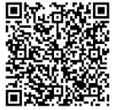
Submit session feedback
Submit session feedback

